Slide 1
DevOps Command Hub
Graduation Project – Proposal

Slide 2
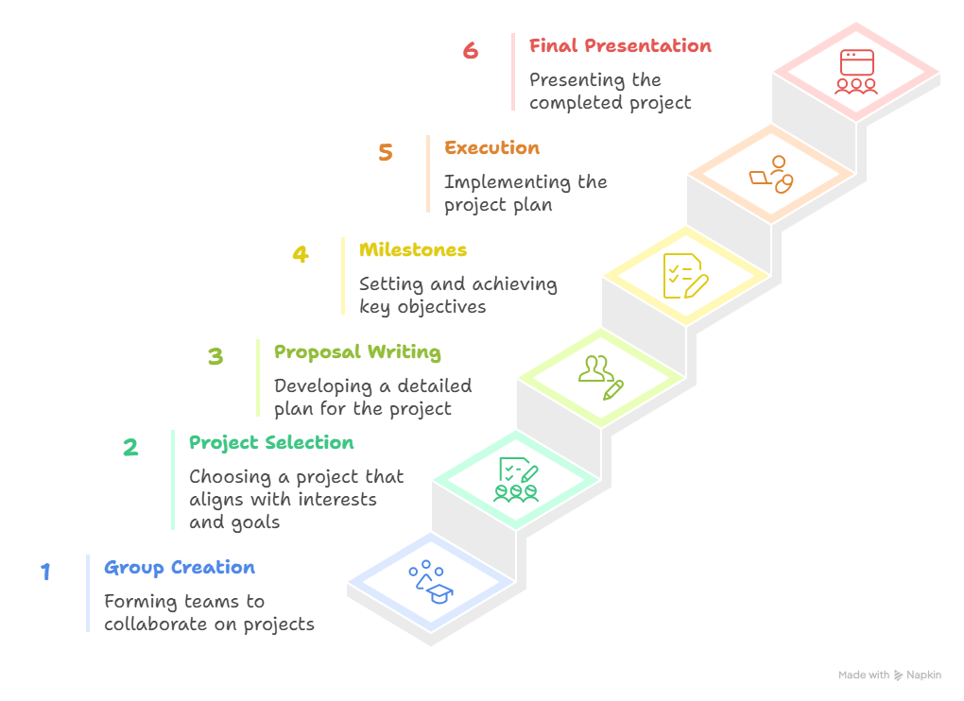
Graduation Project Journey
Team Consist Of 5 Persons , Diverse Background
Project Idea is Self Proposed , Not yet Reviewed By instructor !

Slide 3
Our Team
Ahmed Alhusainy
Mohamed Sherif
Lamiaa Abdallah
Mina Mamdouh
Mohammed Reda
Director
Developer
Programmer
Designer
You can simply impress your audience and add a unique zing.
You can simply impress your audience and add a unique zing.
You can simply impress your audience and add a unique zing.
You can simply impress your audience and add a unique zing.
You can simply impress your audience and add a unique zing.

Slide 4
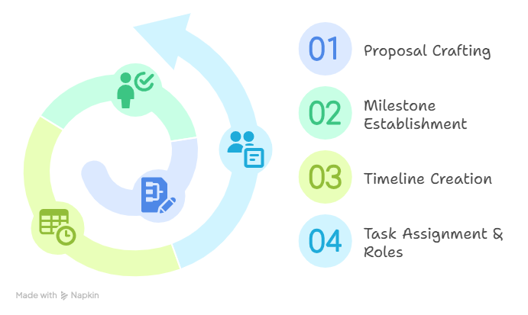
Project Planning And Management

Slide 5
Proposal
At this stage, each team is required to prepare and submit a Project Proposal Document. This proposal acts as the foundation of the Graduation Project and must include the following sections:
Problem Statement – a clear definition of the problem the project aims to solve.
Objectives – the goals the team plans to achieve through the project.
Methodology / Approach – the steps the team will follow, along with the methods to be applied.
Expected Outcomes – the results or deliverables the project is expected to produce.
Tools & Technologies – programming languages, platforms, frameworks, or tools that will be used.

Slide 6
Problem Statement
In modern software development, DevOps teams struggle to maintain visibility, stability, and security across continuous delivery pipelines. While multiple tools exist for monitoring, logging, incident management, and security they are often scattered, complex to integrate, and hard to manage in real time.
This fragmentation leads to:
Slow detection and response to incidents.
Manual investigation of logs and failed deployments.
Limited automation in recovery or security validation.
Lack of unified dashboards combining DevOps + DevSecOps insights.

Slide 7
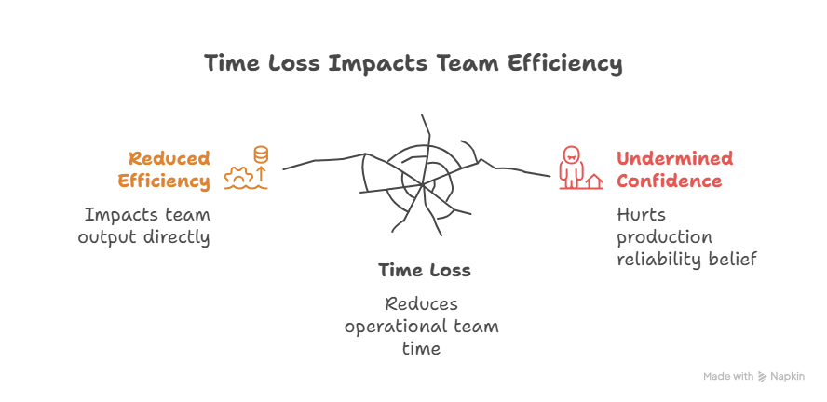
Problem Statement
There is no simple, unified, and intelligent platform that helps teams observe system health, detect incidents, analyze logs with AI, and ensure security compliance — all from one hub.

Slide 8
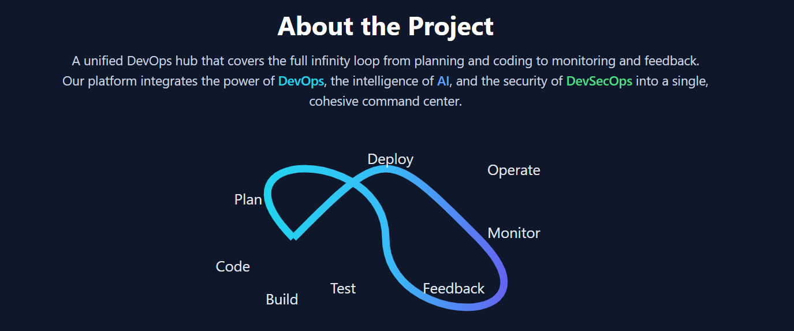
Objectives

Slide 9
Objectives
The DevOps Command Hub aims to create a lightweight, unified platform that helps teams observe, analyze, and improve their DevOps operations with simplicity and intelligence. Through this project, the team plans to achieve the following objectives:
Integrate DevOps observability in one dashboard — combining health metrics, logs, and incidents into a single view.
Enable AI-powered log and incident analysis — provide natural-language explanations and quick insights for developers and operators.
Implement basic self-healing automation — automatically detect and resolve simple infrastructure or service issues.
Embed DevSecOps practices — integrate security scans and highlight vulnerabilities within the CI/CD pipeline.
Design a user-friendly web interface — structured around the DevOps infinity cycle (Deploy, Operate, Observe, Incidents, Logs, Settings).
Demonstrate real use cases — simulate a working pipeline, alerts, and AI responses using open-source tools and sample workloads.

Slide 10
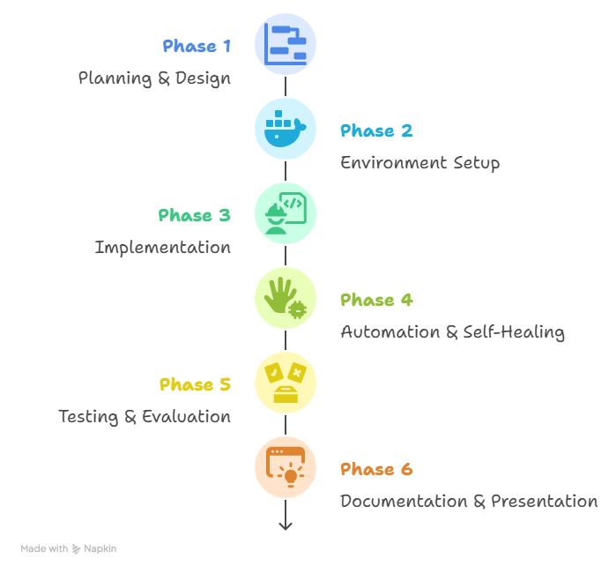
Methodology / Approach
Code/Fetch Online: Simple Full Stack Website
Code Repo Setup
Add templates: README, CONTRIBUTING, SECURITY, issue/PR templates.
Define high level System Architecture – AWS Cloud
AWS Architecture Composer
Design Project Network Topology (Design VPC: 2 public + 2 private subnets, 1 NAT Gateway, route tables, Internet Gateway)
IaC & Configuration - Environment Setup
Terraform: VPC, subnets, SGs, IAM roles, S3 bucket, EC2/EKS, ALB.
Ansible: baseline config for EC2 nodes (packages, users, hardening, agents).
Bastion (not “Bosition”): one small EC2 in a public subnet for controlled SSH.
Optional Proxy: Nginx/Squid if you need outbound egress control.

Slide 11
Methodology / Approach
Build Golden AMI
Containers & Platform
Build Docker images for some the app and utility services.
Build Kubernates For the rest app components
Add ALB + Auto Scaling Group (EC2) or HPA (EKS).
Use AWS RDS – With Best Practice
CI/CD (simple first)
Build & Deploy – CI/CD
Push Code to GitHub
Add Some Modifications as team to ( Merge , ..etc.)
Build & scan image (Trivy)
Enable PR checks and protected branches; team collaborates (merge, reviews).

Slide 12
Methodology / Approach
Observability & Logs (start with managed)
CloudWatch metrics & logs (app/OS).
CloudWatch Alarms → SNS → Slack (via AWS Chatbot) or email.
Stretch: add Prometheus + Grafana (Grafana Cloud free tier) and Loki or OpenSearch.
9. DevSecOps (minimum viable)
Image scanning: Trivy in CI.
IaC scanning: Checkov (Terraform), kube-score (if K8s).
AWS services: Inspector, GuardDuty, Security Hub (enable defaults).
Compliance (if time): OpenSCAP on AMI or nodes; basic CIS checks.
Encryption: enforce S3 SSE, EBS encryption, HTTPS via ACM.

Slide 13
Methodology / Approach
AI Log Analyzer (small & practical)
Start with a simple endpoint that takes a log snippet and returns an explanation:
OpenAI API.
Try Using Managed Or Self Managed Services
Wire it into a “Logs” page: paste filter → “Explain with AI”.
11. Backups & Events
S3 backups for app/config using a Bash script + cron or AWS Backup.
Event-driven actions: Event Bridge (e.g., nightly snapshots, rotation jobs).
12. Optionally – Develop
Present live demo of the Command Hub in operation.

Slide 14
Methodology / Approach – Notes
Secrets management: use AWS Secrets Manager
State management: remote Terraform state (S3 + DynamoDB lock).
Access & RBAC: IAM least-privilege roles; restrict SSH to Bastion; MFA for AWS users.
Cost guardrails: budgets + alerts, small instance sizes, stop non-prod at night.
Data retention: CloudWatch log retention (e.g., 14–30 days) to control cost.
Tagging & naming: consistent tags (Project=DEPI-Ninjas, Env=Dev/Prod) for every resource.
Security reviews: basic threat model + checklist before “final demo”.

Slide 15
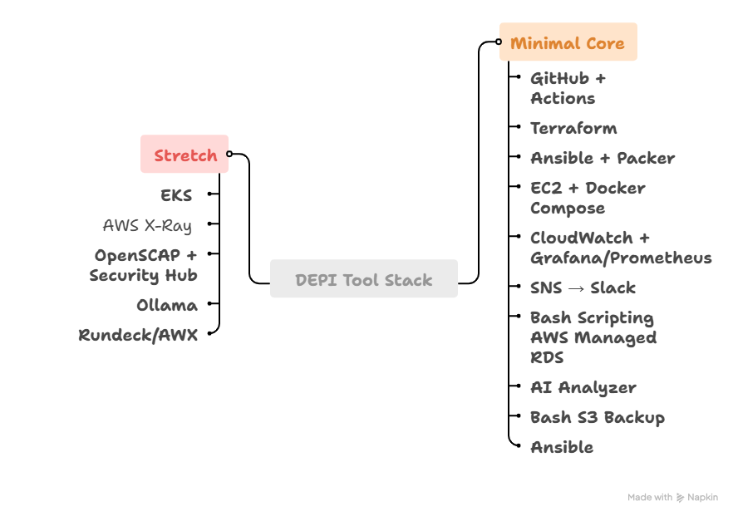
Tools & Technologies
ReactJS
NodeJS
Python
MongoDB/Postgress/mySQL
GitHub
GitHub Actions/Jenkins
EC2 Image Builder
CloudWatch Dashboards
AWS X-Ray
EBS Snapshots via EventBridge
Docker
K8s
YARA/Sigma rules, Trivy, OpenSCAP
Ansible
Prometheus/Grafana, loki/ELK
Ollama for AI
Terraform / Cloud Formation
Bash Scripting
NingX

Slide 16
Expected Outcomes
Apply concepts learned across the curriculum to a working system.
Provision AWS infrastructure with Terraform (optionally compare with CloudFormation).
Build and harden Linux hosts (users, SSH, logs) using Ansible and Packer (Golden AMI).
Containerize services with Docker; run on EC2 (Compose) or EKS.
Implement CI/CD in GitHub Actions (build, scan, deploy, rollback).
Monitor and analyze with CloudWatch (and optionally Prometheus/Grafana).
Centralize logs (CloudWatch Logs; optionally Loki/OpenSearch).
Add AI log explanations (API or local model).
Integrate DevSecOps (Trivy, Checkov; enable Inspector/GuardDuty/Security Hub).
Automate backups to S3 (script or AWS Backup).
Document runbooks, and deliver a live demo of the Command Hub.

Slide 17
Thank You

